Slide 2
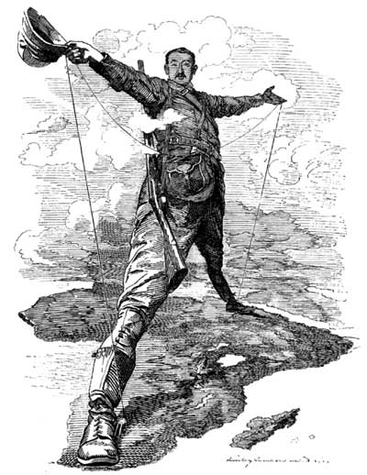
The Age of Imperialism
Chapter 27
1850-1914

Slide 3
What is imperialism?
The seizure (takeover) of a country or territory by a stronger country

Slide 4
What is Imperialism?
Why do Europeans do this?
Industrialization sparks the need for:
Land perfect for establishing trading and military posts
Natural resources and raw materials
New markets for products

Slide 5
What is Imperialism?
Europeans want to control all aspects of their colonies
Politics
Society
Economy
Culture and customs

Slide 6
Types of Imperialism
Methods of Management
Direct Control
Paternalism – Europeans provide for local people but grant no rights
Assimilation – adaptation of local people to ruling culture
Indirect Control
Limited self-rule for local governments
Legislative body includes colonial & local officials

Slide 7
Types of Imperialism
Forms of Control
Colony
Governed by a foreign power
Protectorate
Governs itself, but under outside control
Sphere of Influence
Outside power controls investments & trading
Economic Imperialism
Private business interests assert control

Slide 8
I. The Scramble for Africa
Africa Before European Dominion
Divided into hundreds of ethnic groups
Followed traditional beliefs, Islam or Christianity
Nations ranged from large empires to independent villages
Africans controlled their own trade networks
Europeans only had contact on African coasts

Slide 9
The Scramble for Africa (cont)
Nations compete for overseas empires
Europeans wanted more land
Contained large amounts of gold, diamonds, and rubber
Africa was a mystery to many
Europeans who penetrated Africa were:
Explorers – seeking wealth and notoriety
Missionaries – trying to convert Africans to Christianity
Humanitarians – “westernize” the “savages”

Slide 10
The Scramble for Africa (cont)
Forces Driving Imperialism
Belief in European superiority
Racism
Social Darwinism
Factors Promoting Imperialism in Africa
European technological superiority
Europeans had means to control
New medicines prevent diseases

Slide 11
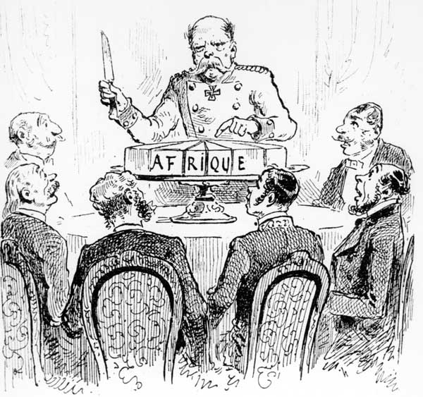
The Division of Africa
The Berlin Conference (1884)
Europeans leaders divide Africa
No African ruler invited
Little or no thought about the complex differences in ethnic groups
By 1914 – Only independent nations
Liberia
Ethiopia

Slide 12
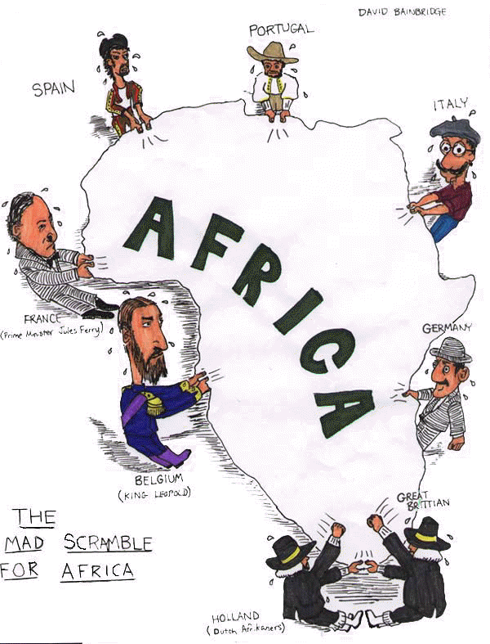
According to this cartoon, which European countries were fighting for a position in Africa?
How did the Berlin Conference lead to the situation shown in the cartoon?

Slide 13
South Africa
Three Groups Clash for Power
Africans
Zulu nation, led by Shaka, fought the British
Zulu nation lost to British in 1887
Boers
Dutch settlers that had controlled South Africa since the mid 1600s
Also known as Afrikaners
British
Gained control of South Africa after the Berlin Conference

Slide 14
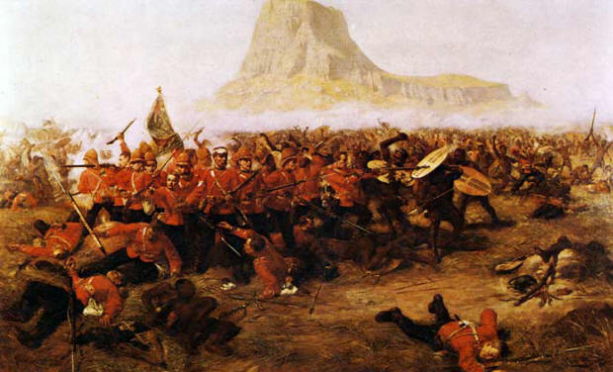
Boer War
Fought between the Boers and the British
Many Africans fought with the Boers
First example of “total war”
British win in 1910
Established the Union of South Africa (British Rule)

Slide 15
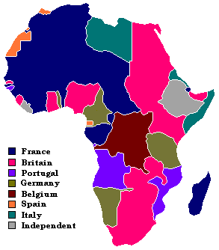
Effects of
European
Imperialism
in Africa

